Slide 1
Identifying Human Emotions from Speech using a CNN Model
Josh Garcia

Slide 2
Purpose
Use a simple CNN model to differentiate between 5 different emotions. This model shows that, while this CNN is successful to a degree and would be more so with more audio files, there may be a better model out there for this specific task.
Notes:
The ability to discern a person’s emotional state solely from their voice is an applicable function in many fields, from customer service to entertainment.
Being able to tell that a consumer is not satisfied with the services provided is a difficult task even for humans, at times.

Slide 3
Dataset
5 emotion classifications (calm, happy, sad, angry, fearful) each for male and female speakers.
24 actors with 60 recordings each
1,440 recordings
Notes:
Inflection, pitch, and volume

Slide 4
Model Architecture - CNN
Two types of CNN were used, with varying results:
A 13-layer model (batch: 16; epoch: 500)
4 1D Convolutional Layers
1 Drop-out Layer midway
Flatten and Dense Layers at the end
and an 18-layer model (batch: 32; epoch: 1000)
6 1D Convolutional Layers
2 Drop-out Layers midway
Flatten and Dense Layers at the end
Notes:
For my CNN model, I used two types of model. A 13 layer model, and an 18 layer model. The differences between them are here on slide 4.

Slide 5
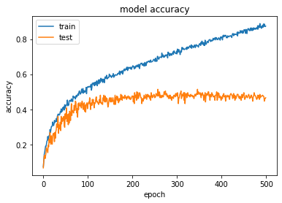
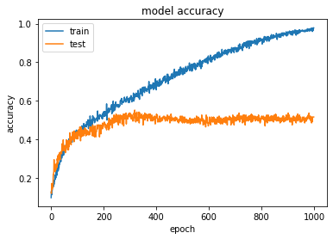
Results
13 layers
Batch: 16 ~45% accuracy
Epoch: 500
18 layers
Batch: 32 ~55% accuracy
Epoch: 1000

